Slide 1
COVID VACCINE Analysis PHASE -4

Slide 2
1: Performing exploratory data analysis
What Is Exploratory Data Analysis?
Exploratory Data Analysis is a data analytics process to understand the data in depth and learn the different data characteristics, often with visual means. This allows you to get a better feel of your data and find useful patterns in it.
You need to know the patterns in your data and determine which variables are important and which do not play a significant role in the output. Further, some variables may have correlations with other variables. You also need to recognize errors in your data.

Slide 3
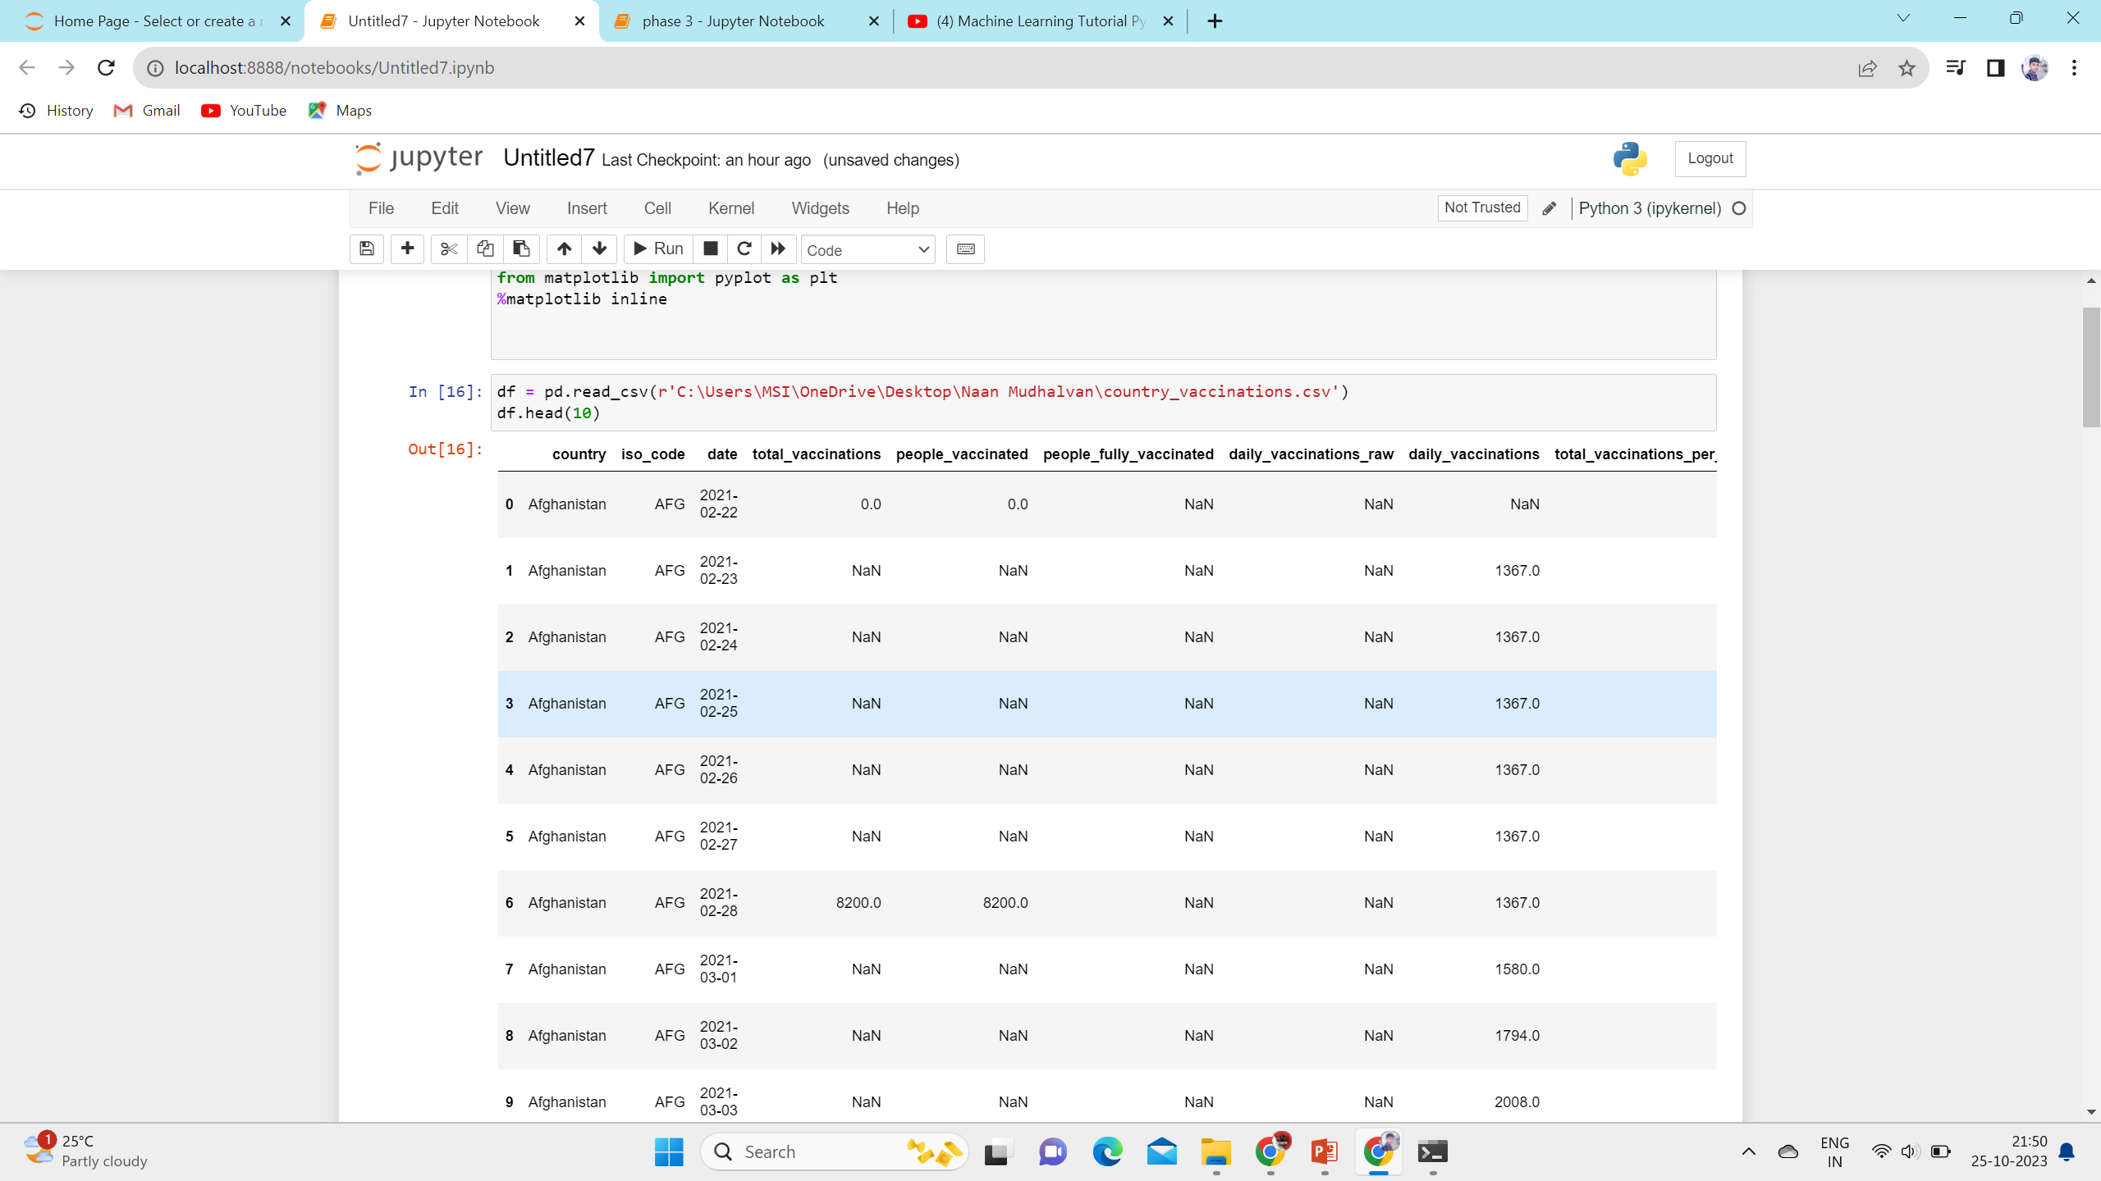
Importing a Dataset

Slide 4
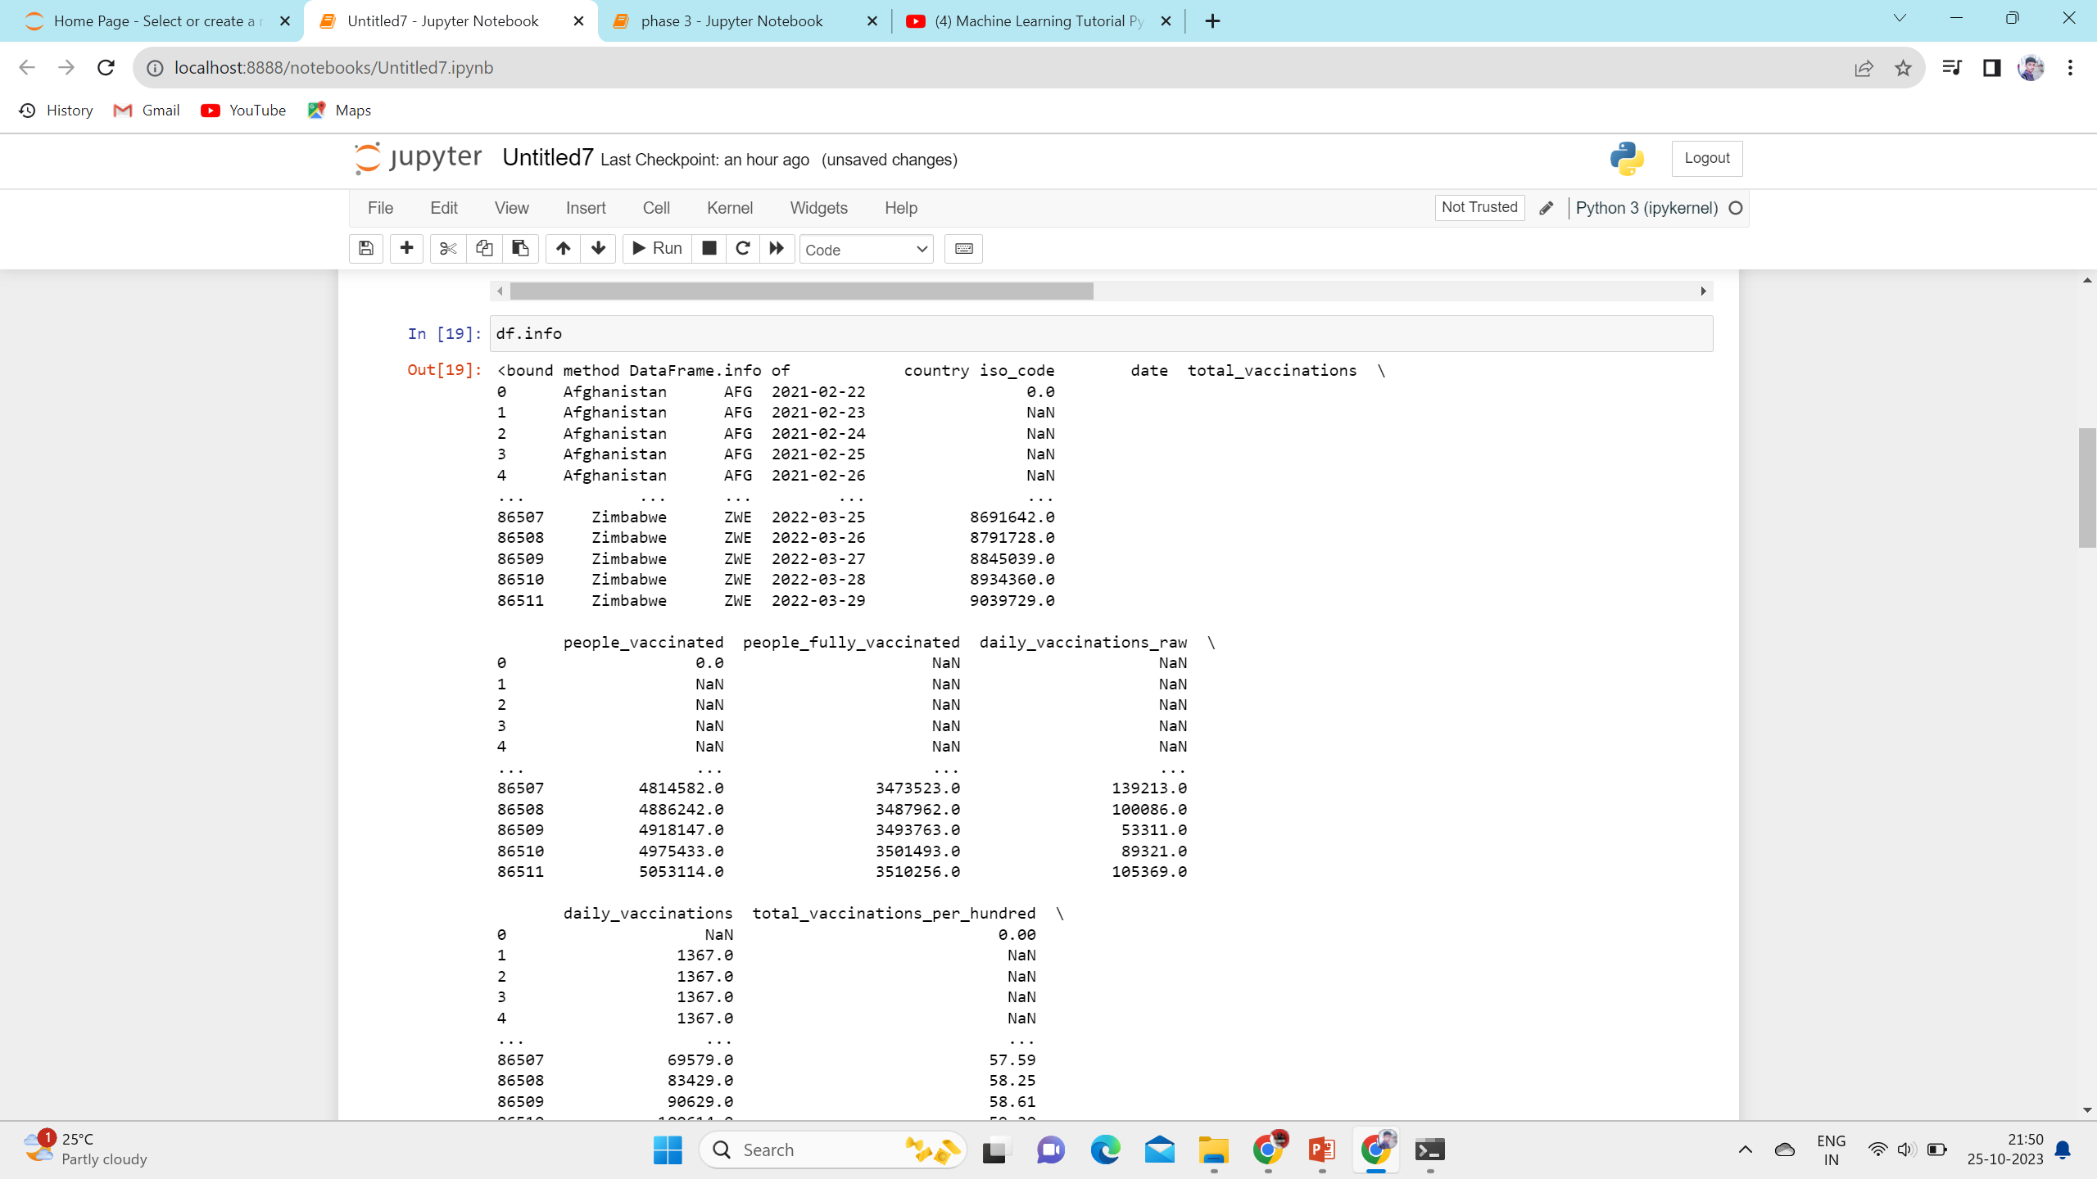
Use info

Slide 5
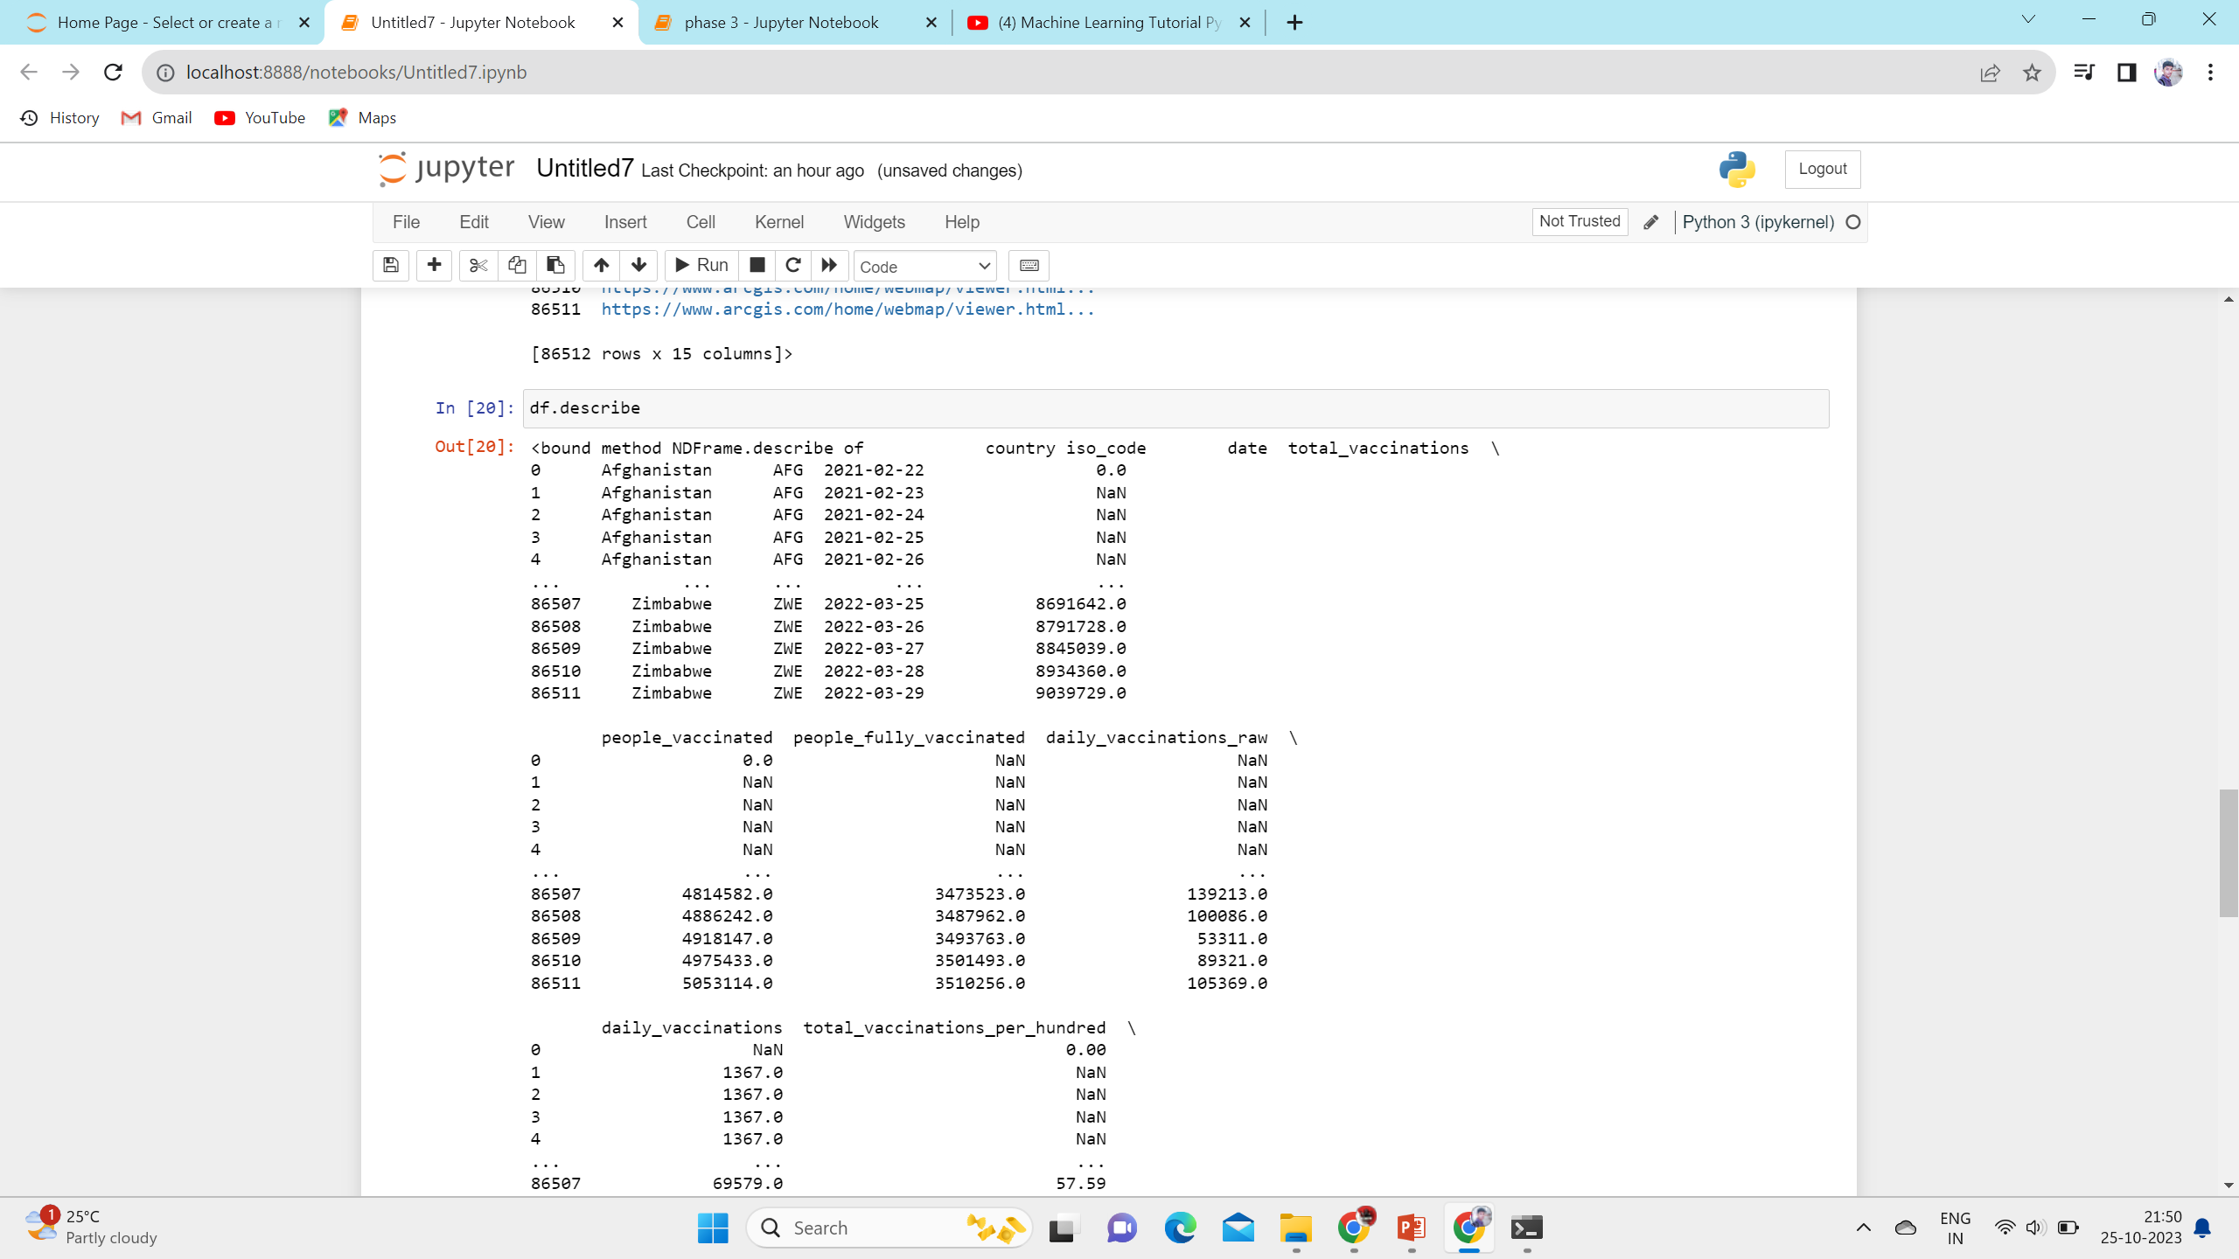
Use describe

Slide 6
2: Statistical analysis
Statistical analysis is the collection and interpretation of data in order to uncover patterns and trends. It is a component of data analytics. Statistical analysis can be used in situations like gathering research interpretations, statistical modeling or designing surveys and studies. It can also be useful for business intelligence organizations that have to work with large data volumes.
Describe the nature of the data to be analyzed.
Explore the relation of the data to the underlying population.
Create a model to summarize an understanding of how the data relates to the underlying population.
Prove (or disprove) the validity of the model.
Employ predictive analytics to run scenarios that will help guide future actions.

Slide 7
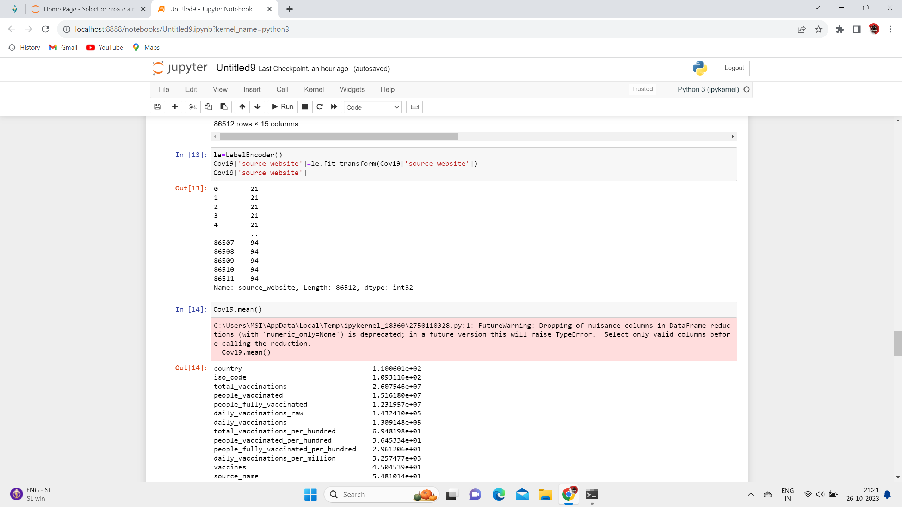
The five basic methods are mean, standard deviation, regression, hypothesis testing, and sample size determination. It is widely used by governments, businesses, banking entities, insurance companies, etc

Slide 8
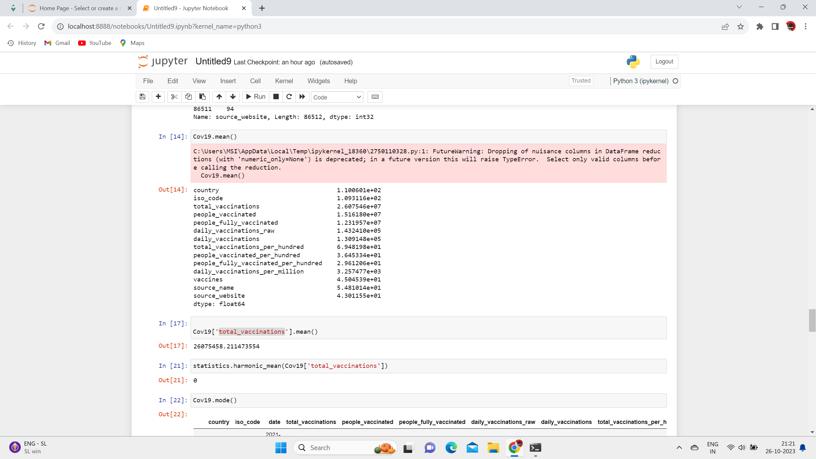
MEAN()

Slide 9
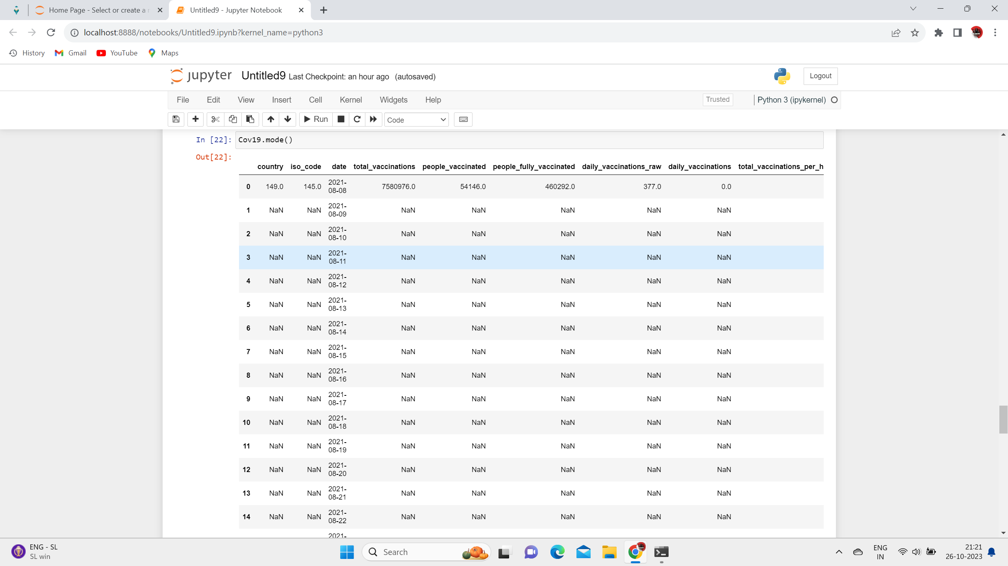
MODE()

Slide 10
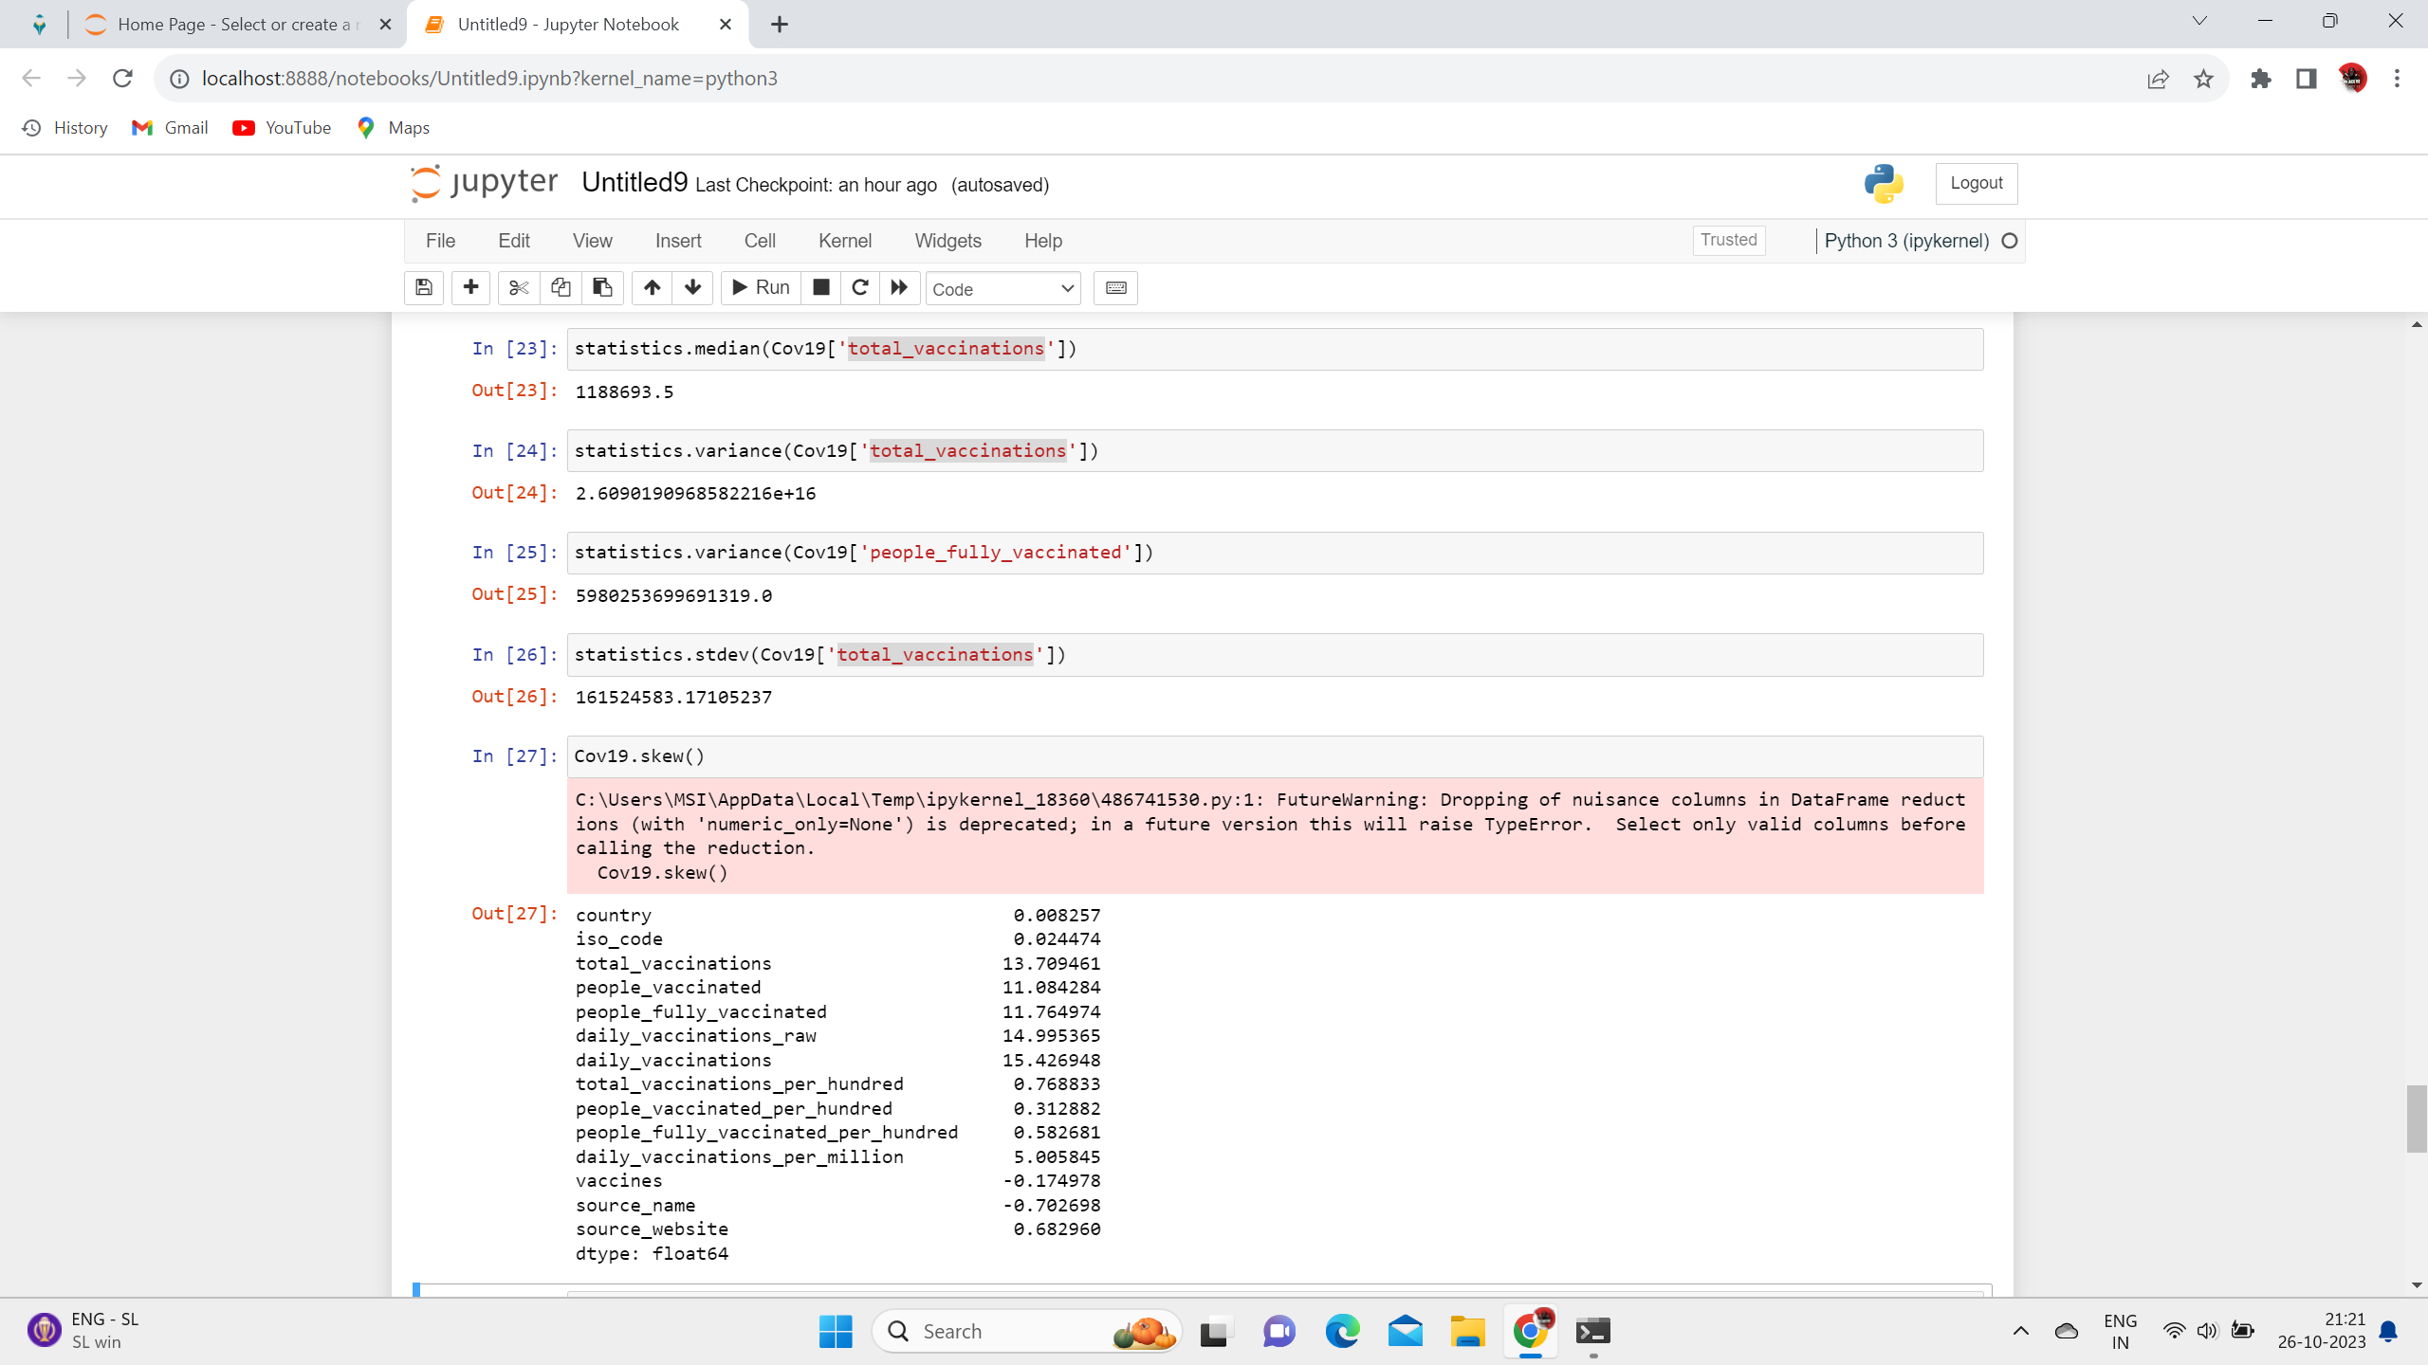
Median , Variance

Slide 11
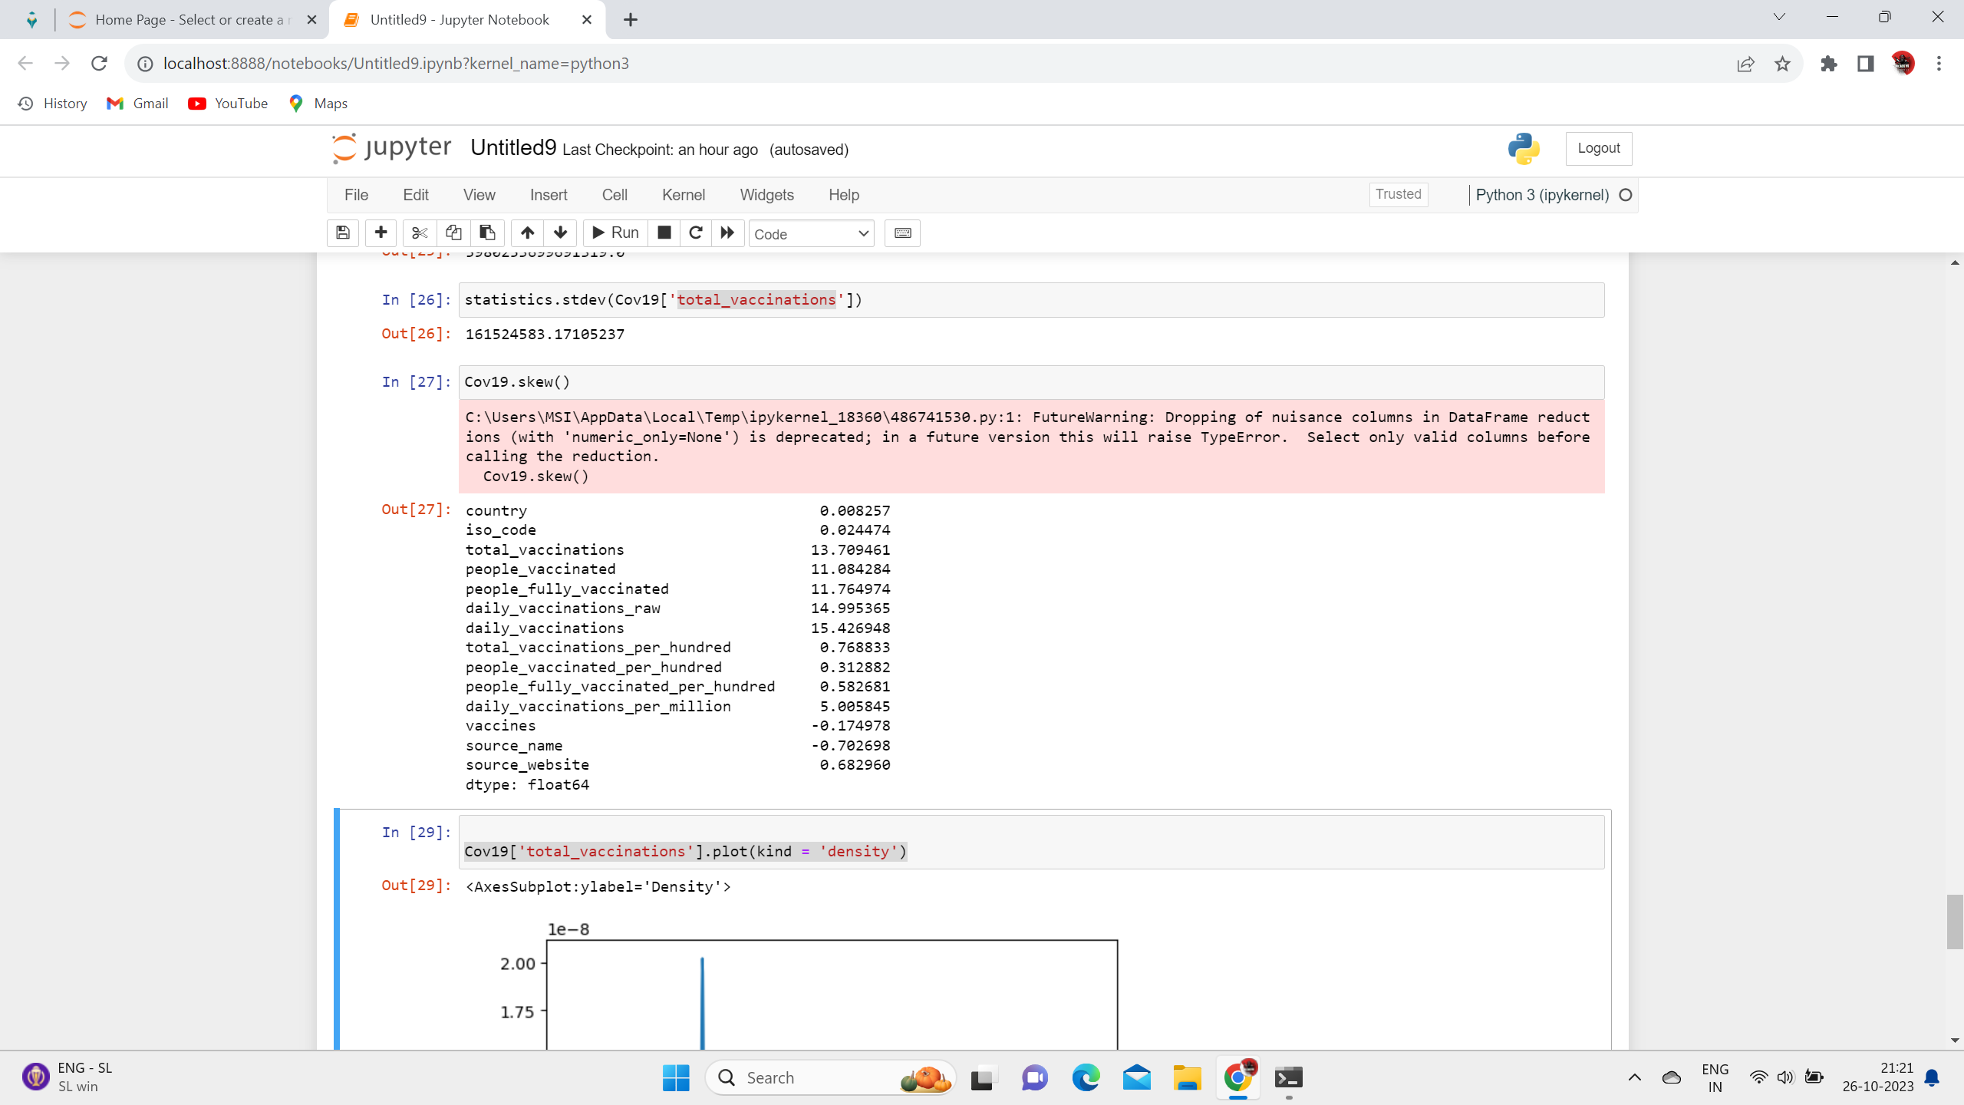

Slide 12
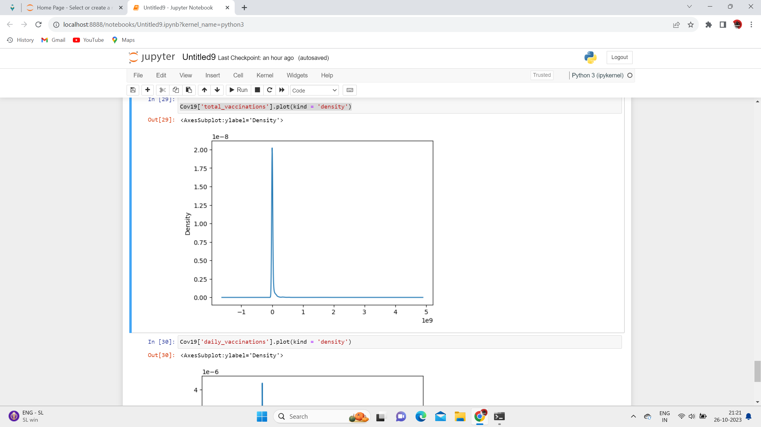

Slide 13
3: Visualization
Visualization (graphics), the physical or imagining creation of images, diagrams, or animations to communicate a message. Data and information visualization, the practice of creating visual representations of complex data and information.
Like:
Linear Regression
Kmeans
Decision Tree
KNN,etc..

Slide 14
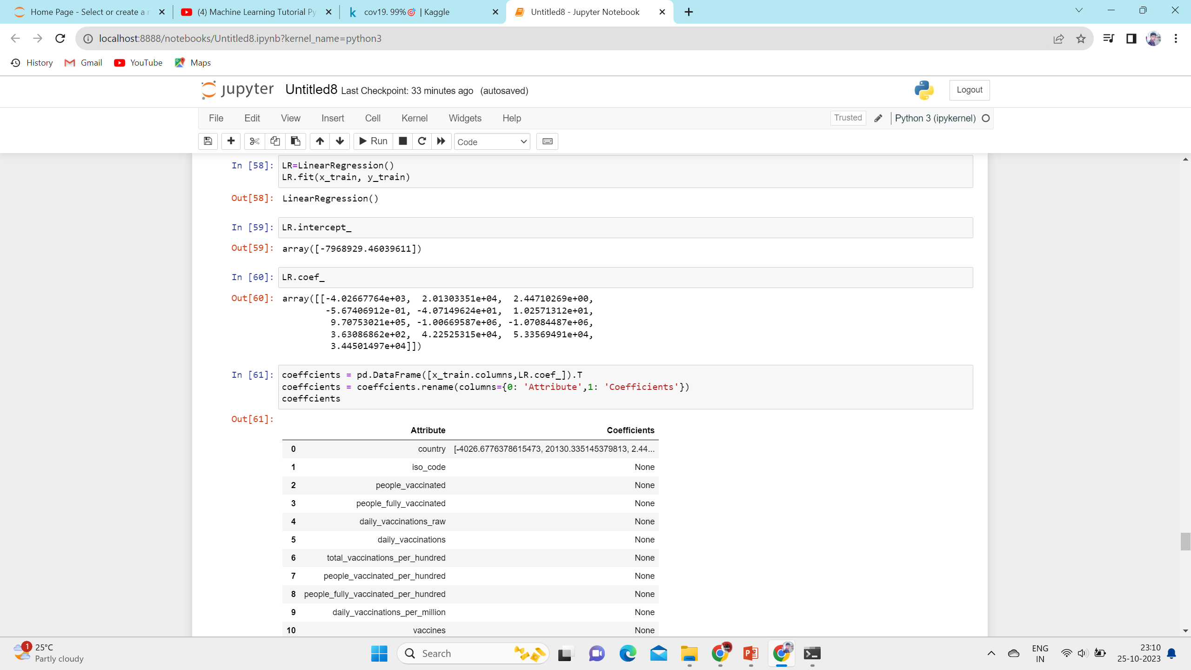
Using Linear Regression

Slide 15
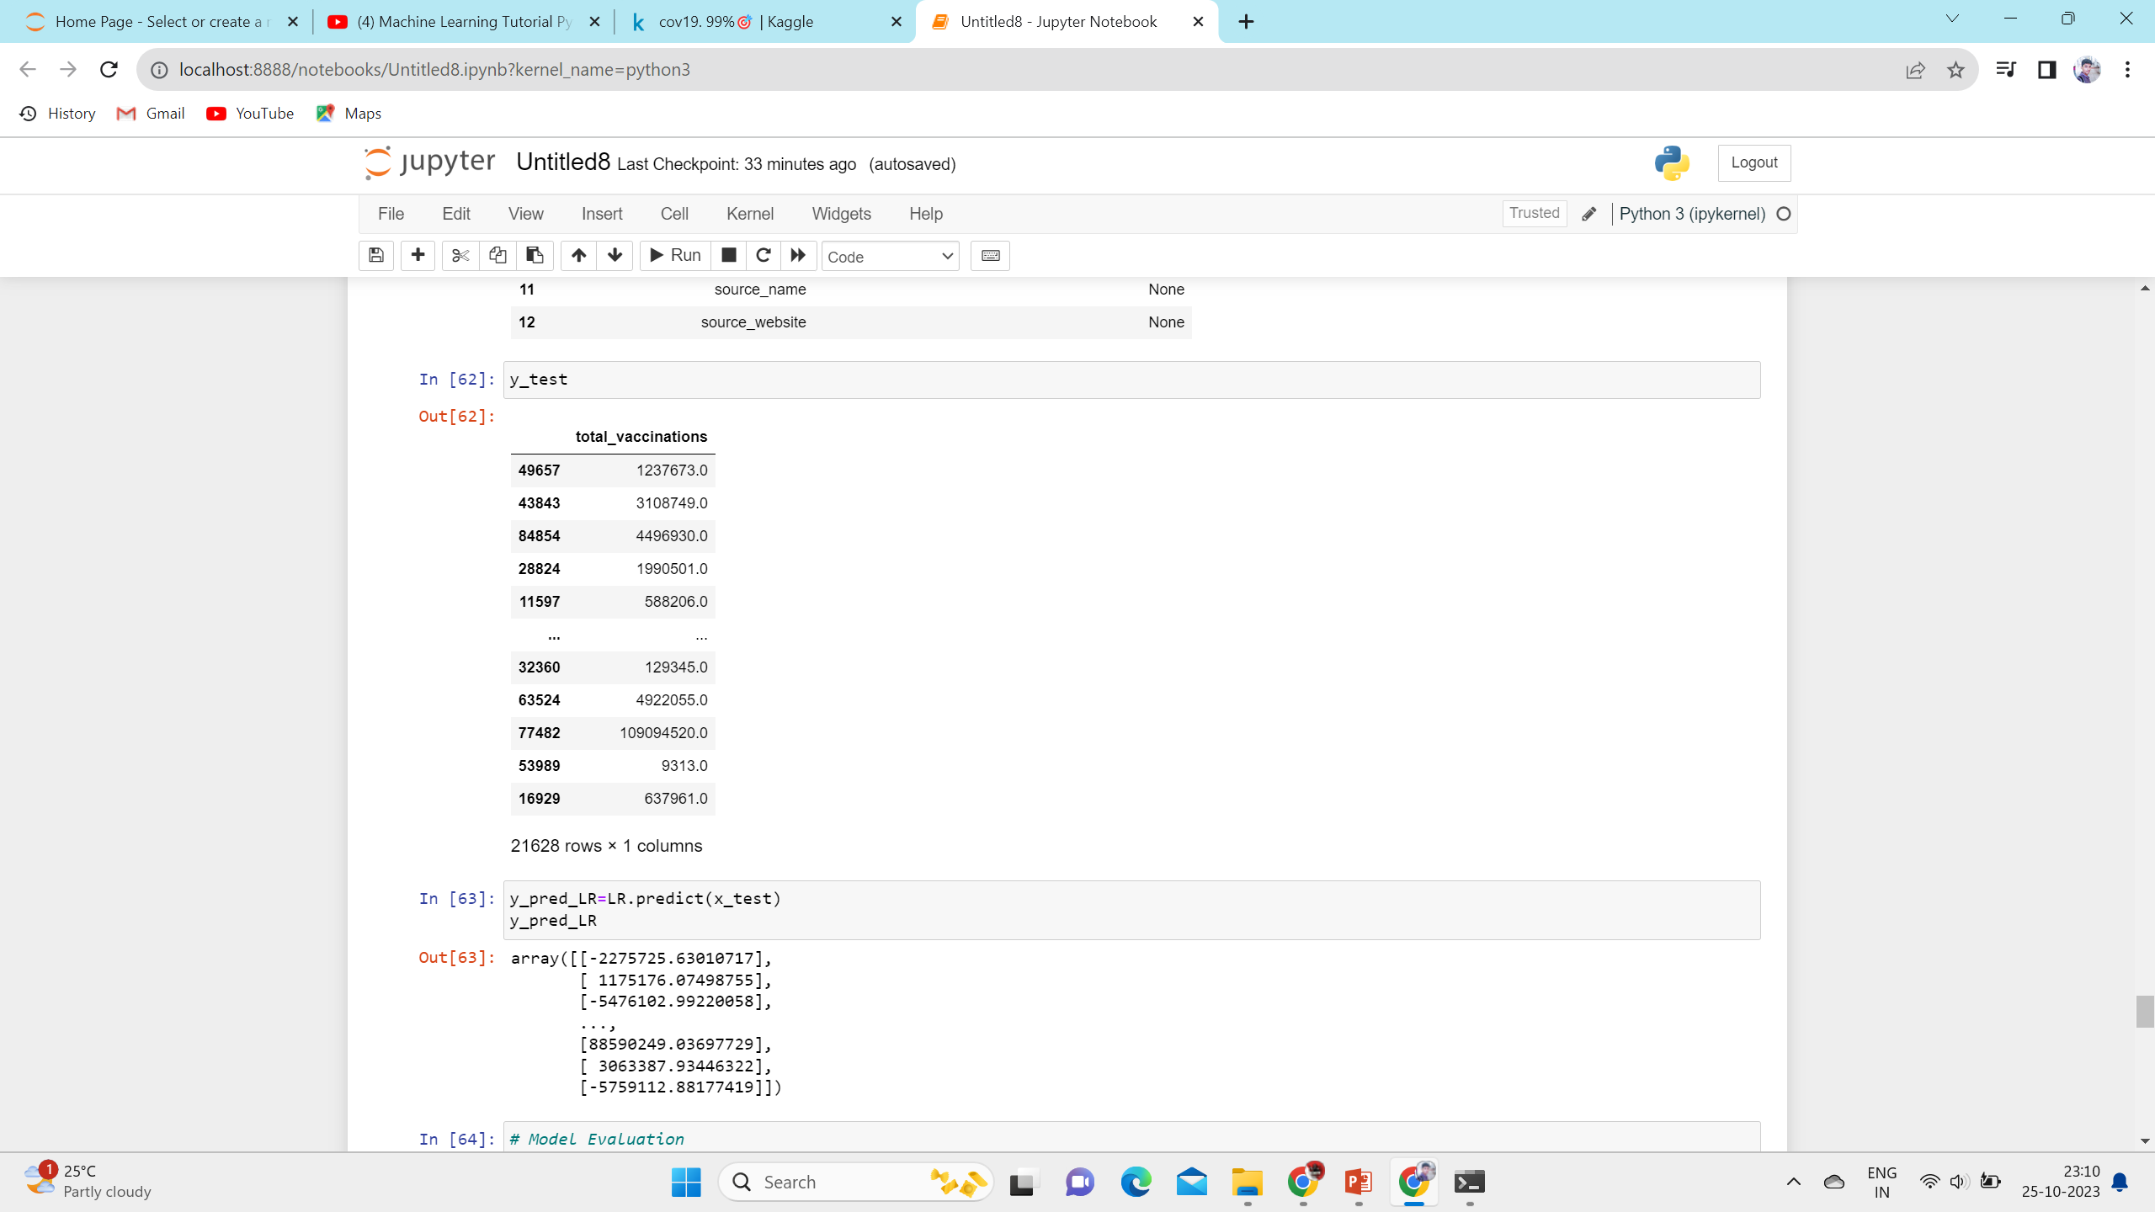

Slide 16
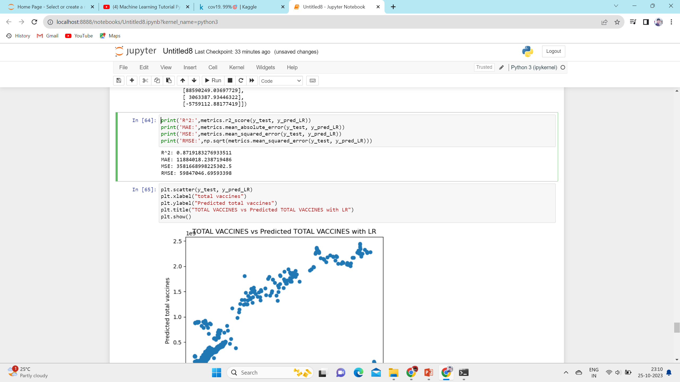

Slide 17
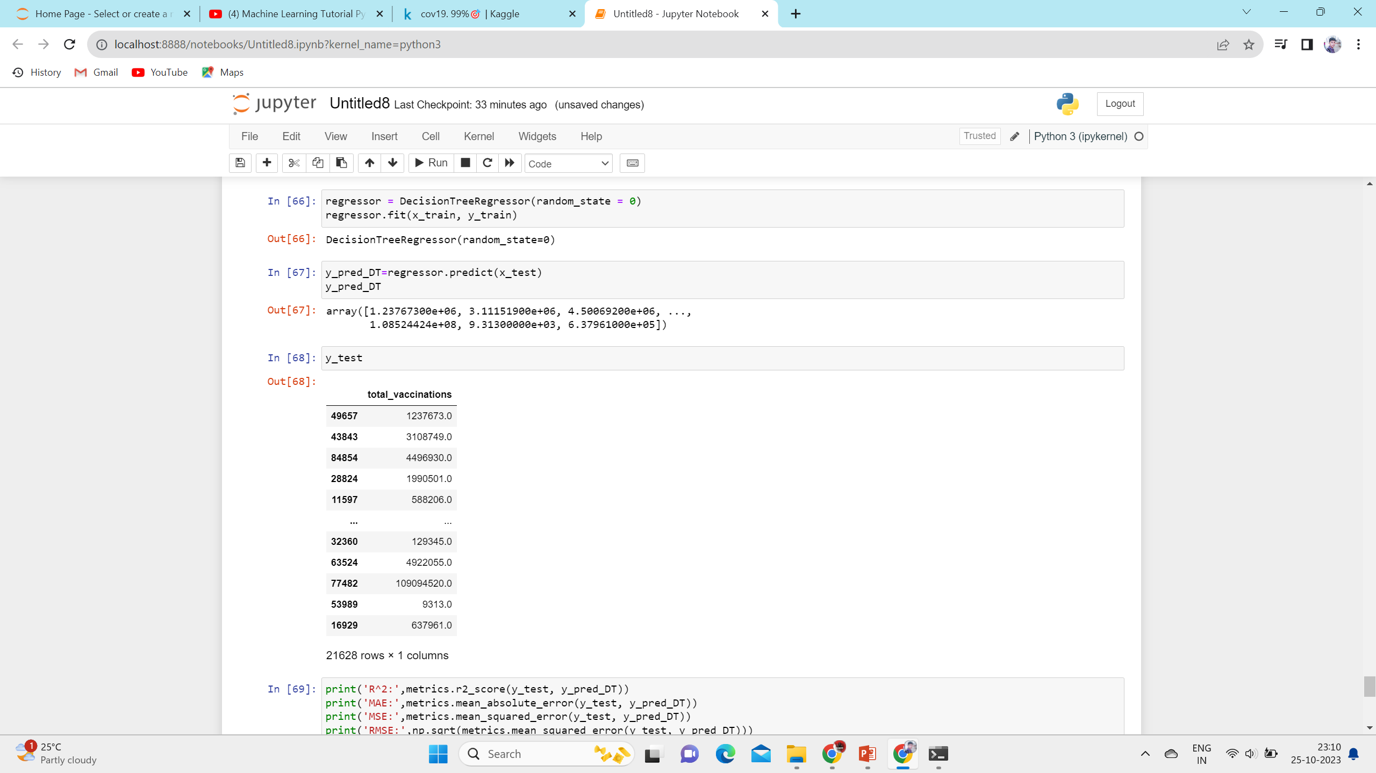
2.2 Decision Tree Algorithm

Slide 18
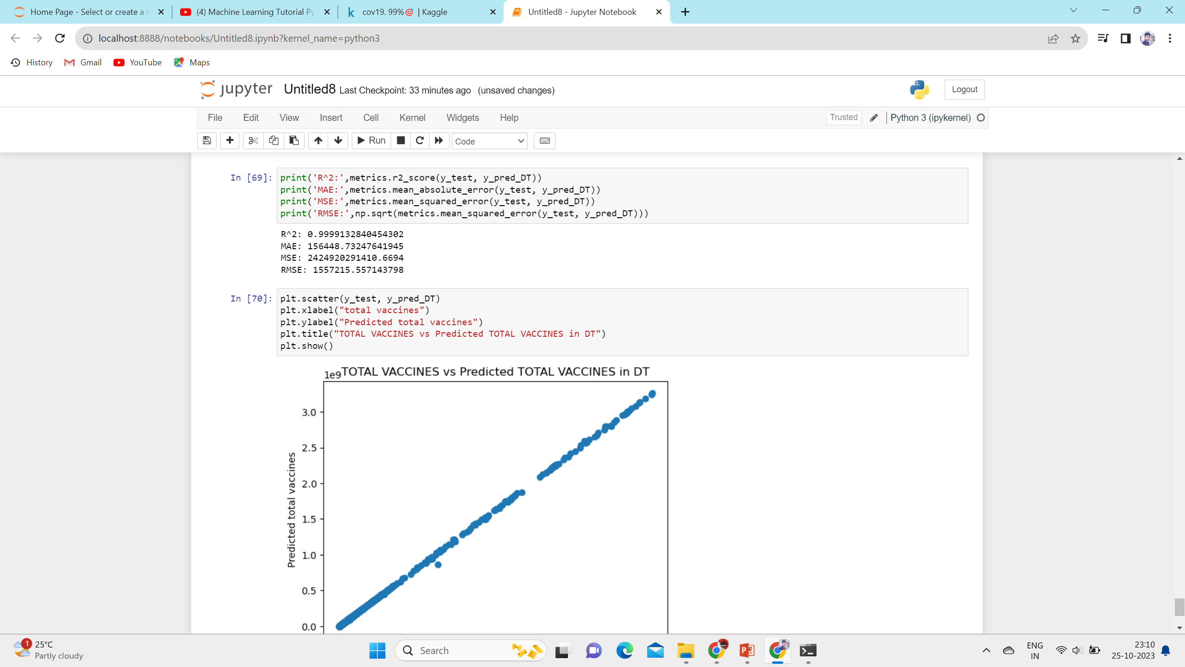

Slide 19


